Slide 1

Real Estate Marketing Analytics on Airbnb in Washington

Slide 2
Introduction
Real estate marketing analytics is a crucial aspect of the hospitality industry, especially for home-sharing platforms like Airbnb. The success of a property on Airbnb depends largely on its ability to attract and retain guests, and data-driven insights can help hosts make better decisions to improve their properties' performance. In this presentation, we will delve into the world of real estate marketing analytics on Airbnb in Washington, exploring the key metrics and trends that hosts should be aware of to maximize their revenue potential.
Washington is a popular destination for travelers, with a diverse range of attractions and a thriving hospitality industry. The city's home-sharing market is also highly competitive, with thousands of properties listed on Airbnb alone. As such, hosts need to have a thorough understanding of the market dynamics and guest preferences to stay ahead of the competition. Real estate marketing analytics can provide valuable insights into these areas, helping hosts identify opportunities to optimize their pricing, improve their listings, and enhance the guest experience. In the following sections, we will examine some of the key metrics and tools that hosts can use to leverage real estate marketing analytics and succeed on Airbnb in Washington.

Slide 3
Motivation
Washington DC is one of the leading markets in Airbnb demand. This is due to its constant flow of visitors from around the world and other US states who attend conferences or visit the White House. Airbnb pricing in Washington, D.C. Marketing project does have creative expression, data-driven decision making, collaboration, and the opportunity to make an impact.
Creative expression: Working on a marketing project for Airbnb pricing in Washington DC allows individuals to express their creativity and develop innovative marketing strategies to attract more bookings and generate higher revenue.
Data-driven decision making: Marketing projects related to Airbnb pricing in Washington DC require individuals to analyze data and use insights to inform marketing decisions. This provides an opportunity to use data to drive marketing strategies and measure the effectiveness of marketing campaigns.
Collaboration: Marketing projects often require collaboration with other team members, including data analysts, designers, and content creators. This allows individuals to work in a team environment and learn from others with different skill sets.
Learning opportunity: Working on a marketing project for Airbnb pricing in Washington DC provides an opportunity to learn about the short-term rental industry and gain a deep understanding of how pricing and marketing strategies impact demand.

Slide 4
Swot Analysis
Strengths:
Airbnb provides a new and unique form of accommodation for tourists visiting Washington, D.C.
Airbnb can generate additional income for homeowners and local hosts, potentially boosting the local economy.
Airbnb provides a more affordable option for travelers compared to traditional hotel accommodations.
Weaknesses:
Airbnb may drive up housing costs and contribute to gentrification and displacement of residents.
Airbnb may lead to a decline in the quality of life for residents in heavily tourist-visited neighborhoods.
Airbnb hosts may not be subject to the same regulations and taxes as traditional hotels, creating an unfair competition.
Opportunities:
Local policymakers and stakeholders can collaborate with Airbnb to develop regulations that benefit both hosts and residents.
Airbnb can be leveraged as a tool for economic development, by creating new jobs and opportunities in the tourism industry.
Airbnb can help increase the visibility and attractiveness of Washington, D.C. as a tourist destination.
Threats:
Airbnb may cause an increase in housing prices and rental costs, making it more difficult for residents to afford living in the city.
Airbnb may have negative impacts on the culture and character of local neighborhoods, leading to a loss of community identity.

Slide 5
Steps to Perform Airbnb analysis
Define the problem
Data collection
Data preprocessing
Feature extraction
Visualization

Slide 6
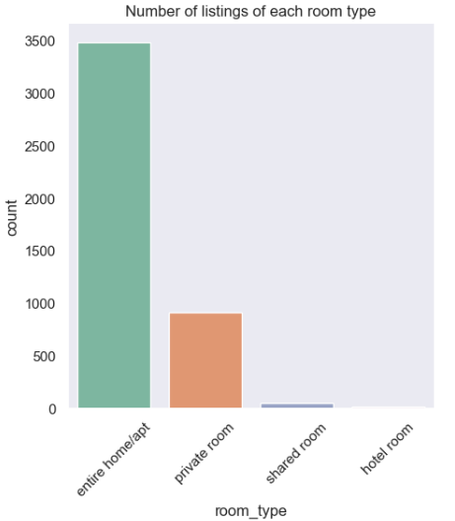
Analysis of Airbnb listings based on their room types
Insights:
The plot suggests that most people prefer to rent out an entire home/apartment rather than sharing their space with others. Virgin America got the least number of reviews constituting of overall 3% only.
This could be because people value their privacy and prefer having their own space while traveling.
Additionally, the pandemic may have also contributed to this trend, as people may feel more comfortable staying in a private space rather than sharing a room or common areas with strangers.
Recommendations:
Create detailed descriptions and attractive visuals that showcase the benefits of each room type.
Consider offering discounts or special perks to guests who book less popular room types.
Use social media and other marketing channels to showcase the unique benefits of each room type and attract a wider audience to your listing.
Consider investing in comfortable beds, quality linens, and other amenities to improve the overall experience for guests.

Slide 7
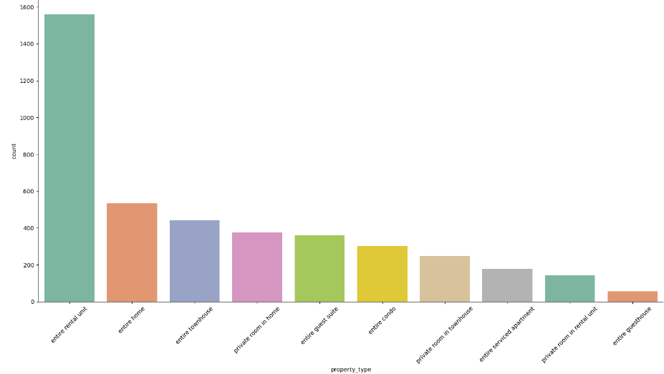
Analysis of listings based on the property type
Insights:
The count plot shows that the most common listing types in Washington are entire rental units, followed by entire homes and entire townhouses.
These types of listings typically offer guests more space and privacy compared to private or shared rooms, which could explain their popularity.
The lower count for entire guest houses could be due to a variety of reasons, such as fewer guest houses available in Washington, less demand for this type of listing, or higher prices compared to other types of listings.
Recommendations:
To differentiate your listing from competitors, consider offering unique and desirable amenities that guests are looking for, such as a hot tub, outdoor space, or a convenient location near popular attractions.
Ensure that your listing is well-maintained and clean, with comfortable and attractive furnishings.
To differentiate your listing from competitors, consider offering unique and desirable amenities that guests are looking for,.

Slide 8
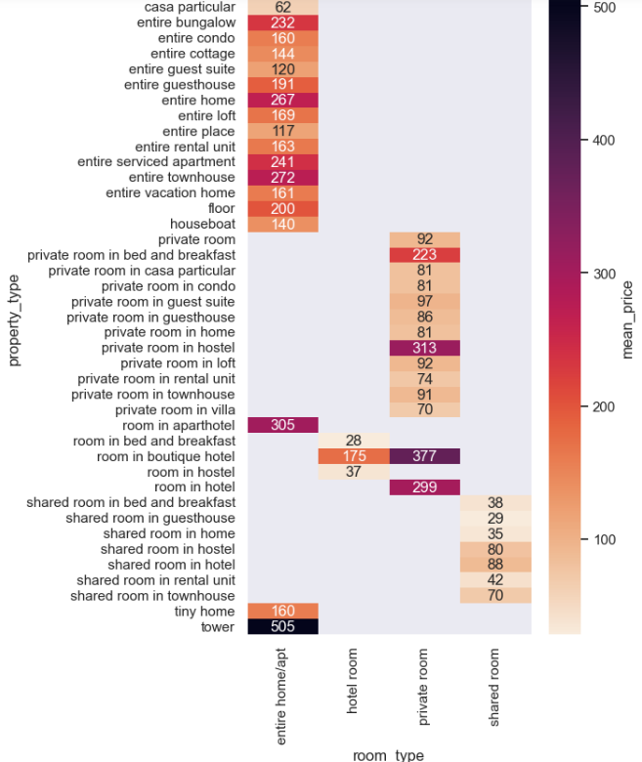
Analysis of prices for the different room and property types.
Insights:
The heatmap reveals that both the room type and property type significantly impact the pricing of Airbnb listings in Washington.
Shared rooms, which are typically the cheapest option and offer the least amount of privacy, are shown to have the lightest color on the heatmap, indicating lower prices.
In contrast, entire houses, which offer the most space and privacy, have the darkest color, indicating higher prices. Private rooms fall somewhere in between on the price spectrum.
Recommendations:
Hosts should consider the room type and property type when setting their prices.
Shared rooms should be priced lower than private rooms and entire homes or apartments.
Hosts should research comparable listings in their area to ensure their pricing is competitive and reflective of the value of their listing.

Slide 9
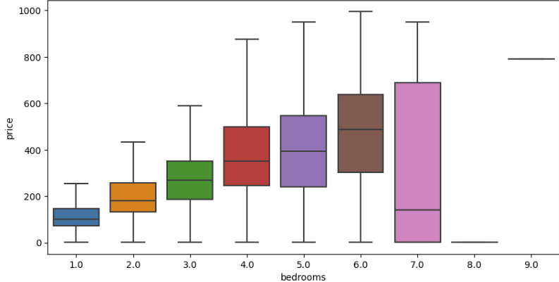
Analysis of listings based on the number of bedrooms
Insights:
The boxplots reveal that there is a clear correlation between the number of bedrooms and the price of Airbnb listings in Washington.
As the number of bedrooms increases, so does the median price, with listings with four or more bedrooms having the highest median prices.
Recommendations:
Hosts should consider the number of bedrooms when setting their prices. As the number of bedrooms increases, the median price also increases, so hosts should adjust their pricing accordingly to reflect the added value of more bedrooms.
While the number of bedrooms is an important factor in pricing, other factors such as location, property type, and overall quality of the listing should also be considered.
Hosts should research comparable listings in their area and ensure that their pricing is competitive and reflective of the value of their listing.

Slide 10
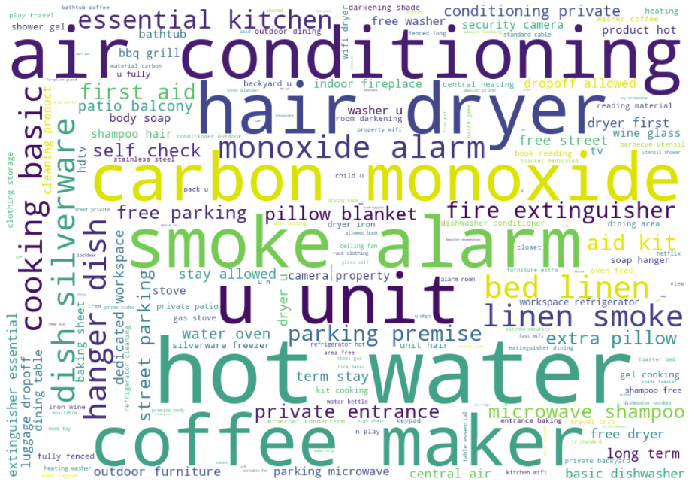
Analyzing Amenity resulting in Higher Prices.
Insights:
Certain amenities can greatly influence the price of a listing. In particular, amenities such as ‘Hot Water', 'Dryer', 'Heating', 'Wireless Internet', 'Smoke Detector', and 'Free Parking' are commonly found in the most expensive listings.
Hosts should consider offering these amenities to justify a higher price for their listing.
The type of room and property also play a significant role in the price of a listing.
Recommendations:
Hosts should consider offering amenities such as Washer, Dryer, Heating, Wireless Internet, Smoke Detector, and Free Parking to justify a higher price for their listing.
Hosts should consider listing their entire property, such as entire apartments and houses, to potentially fetch higher prices.
Hosts should consider investing in unique and rare property types, such as boat houses, to potentially increase the value of their listing.

Slide 11
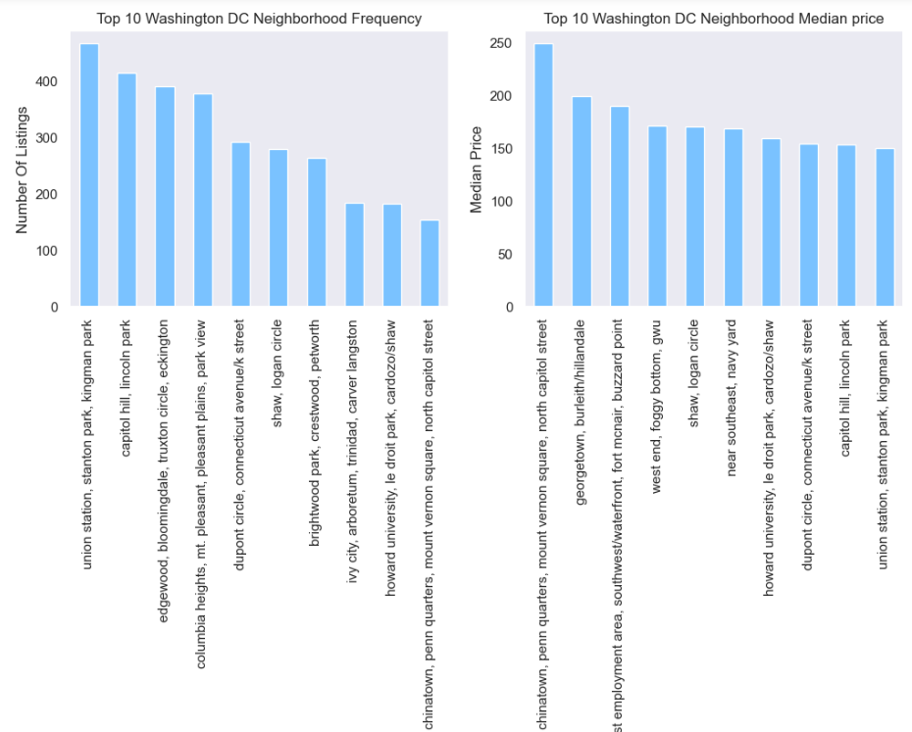
Top 10 No. of Listings and Median Price with Neighborhood
Insights:
Our analysis shows that certain neighborhoods tend to have higher median prices compared to others. This could be due to various factors such as the neighborhood's proximity to popular tourist attractions or the quality of the properties in the area.
While some expensive neighborhoods have a high number of listings, others have fewer listings. This could be due to various factors such as limited availability of properties or the exclusivity of the neighborhood.
Recommendations:
The location of a property can greatly impact its pricing. Hosts should analyze the neighborhood in which their property is located and compare its pricing with similar properties in the area.
If the neighborhood has high demand and limited availability, they can consider setting a higher price.
While the location is important, hosts should also ensure that their property offers the amenities and quality that justify the price. Guests are willing to pay more for properties that offer unique features and a higher quality experience.

Slide 12
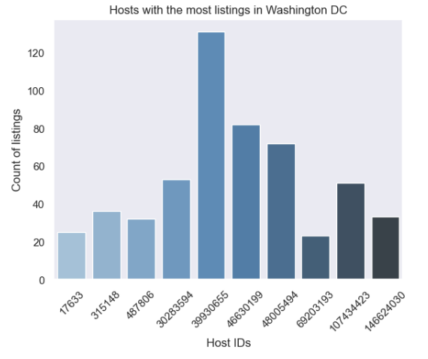
Top 10 Hosts (IDs) having the most listings on Airbnb
Insights:
The fact that the top 10 hosts have a good distribution in the number of listings they have indicates that Airbnb in Washington is not monopolized by a small group of hosts. This is a positive sign as it suggests healthy competition and a diverse range of options for guests to choose from.
It is also worth noting that having many listings can potentially increase a host's revenue, but it can also require more resources and management efforts to maintain those listings. As such, hosts should carefully consider the potential benefits and drawbacks before expanding their listings.
Recommendations:
Hosts should strive to offer unique and high-quality listings to stand out among the competition. This can include adding desirable amenities and providing excellent customer service.
Hosts should carefully manage their listings to ensure that they are offering a high-quality experience to guests. This can include regular maintenance, prompt communication, and attention to detail.
Hosts should consider expanding their listings if they have the resources and capacity to do so but should also be mindful of the potential drawbacks such as increased management efforts and the need for additional resources. It may be more beneficial to focus on improving the quality of existing listings before expanding.

Slide 13
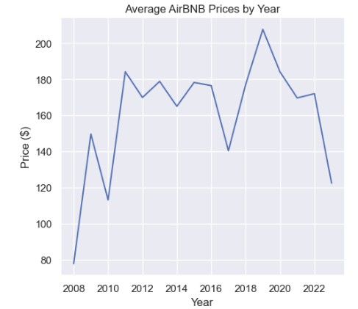
Average Airbnb Prices in Washington By Year and Month
Insights:
The line chart shows that the average price of Airbnb listings in Washington, D.C. has fluctuated over the years, with some years seeing a significant increase in price.
The year 2009 had the highest increase in average price compared to the previous year, while the years 2011 and 2016 saw significant decreases in average price compared to the previous year.
The peak average price occurred in the year 2018. These insights can be used by hosts to adjust their pricing strategies based on market trends and demand.
Recommendations:
Hosts should be aware of the trend of seasonal fluctuations in prices and adjust their rates accordingly to maximize their profits.
Hosts should also monitor the market trends closely and adjust their pricing strategy accordingly.
Guests should also be aware of the seasonal fluctuations in prices and plan their travel accordingly to save money. They can consider traveling during the off-season or mid-week to take advantage of lower prices.

Slide 14
References
Schonfeld, Erik (11 August 2008). "AirBed And Breakfast Takes Pad Crashing To A Whole New Level". TechCrunch. Retrieved 13 December 2012.
Lawler, Ryan (January 30, 2015). "Airbnb To Begin Collecting Taxes In Amsterdam, San Jose, Chicago, And Washington, D.C." TechCrunch. Retrieved July 6, 2015.
Wang, Amy B.; Wang, Amy B. (2017-01-29). "Airbnb offers free housing to refugees and others in limbo after Trump's executive order". Washington Post. ISSN 0190-8286. Retrieved 2017-01-30.

Slide 15
Thank You

